Slide 1
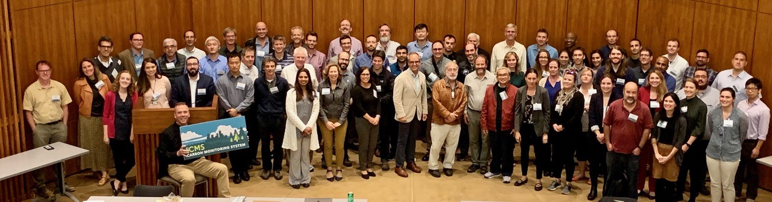
Overview of NASA
CMS Applications Efforts
Edil A. Sepúlveda Carlo, CMS Applications Coordinator
Senior Research Scientist at NASA Goddard Space Flight Center / SSAI
2023 CMS Applications Workshop, Pasadena, CA – Sept 26, 2023
CMS Applications Team: Ben Poulter, NASA GSFC; Molly Brown, Univ of Maryland; George Hurtt, Univ of Maryland; Peter Griffith, NASA GSFC/SSAI; Sabrina Delgado Arias, NASA GSFC/SSAI

Slide 2
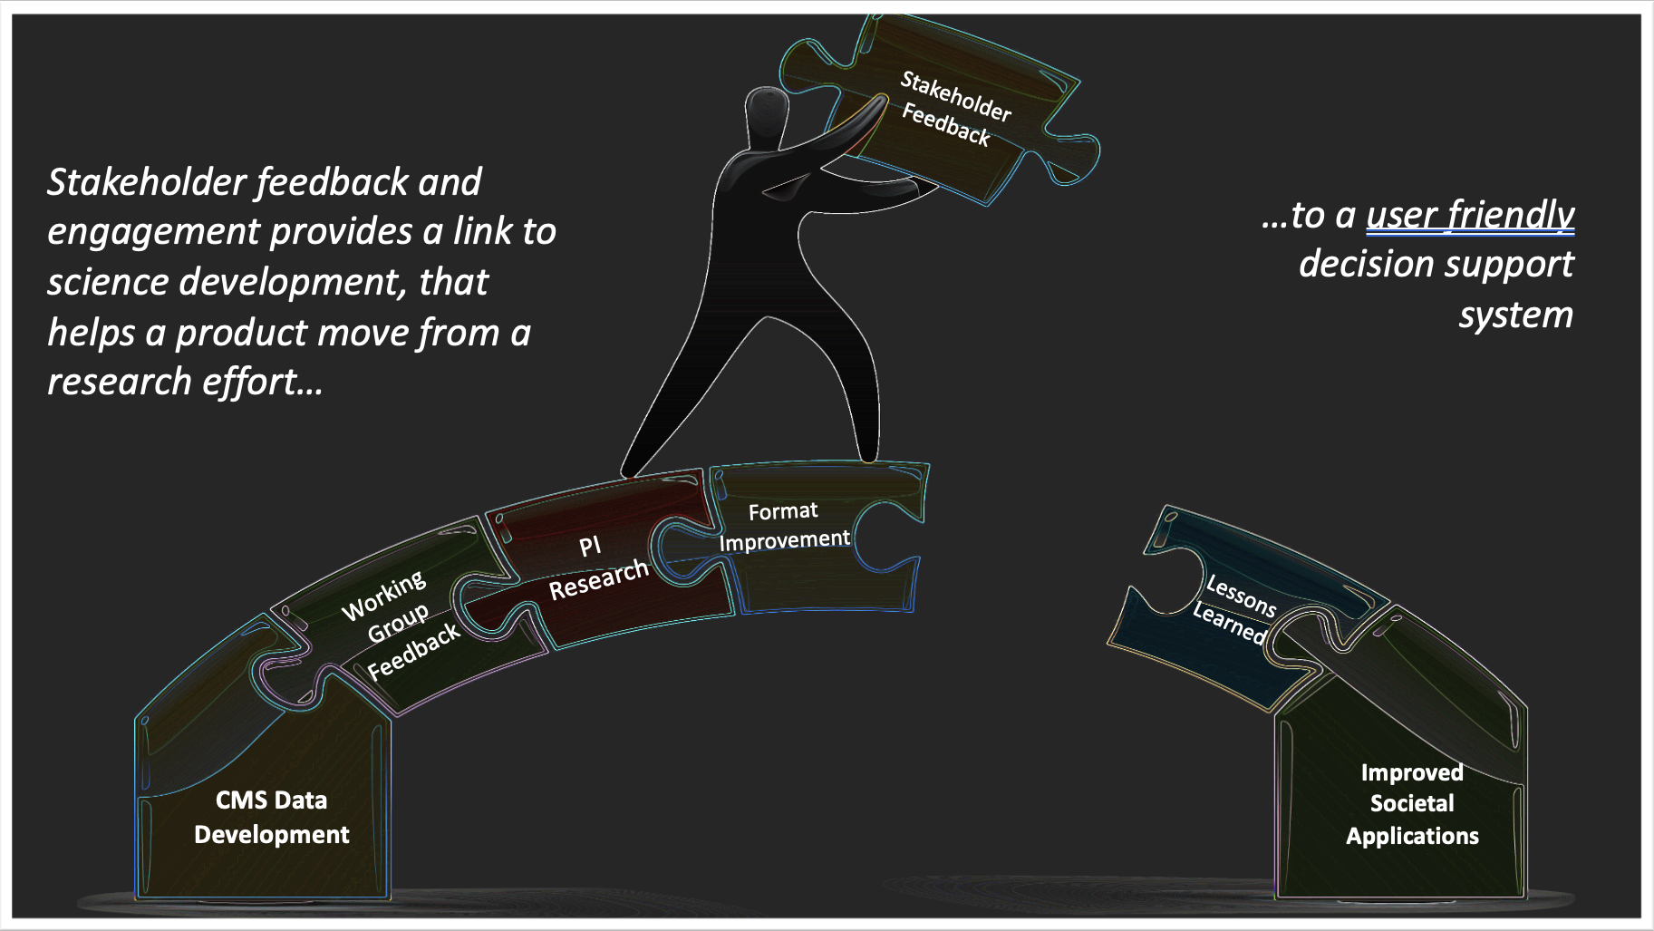
Goals of CMS Applications Efforts
Rapidly initiate generation and distribution of products, both for evaluation and to inform near-term policy development and planning. Engage with, and contribute to, related U.S. and international stakeholders and agencies.
Link Stakeholders to CMS science products.
Provide a path for feedback and lessons learned for CMS PIs so CMS is more accessible and user friendly.
Inform NASA HQ of the needs and requirements of the carbon end user community.

Slide 3
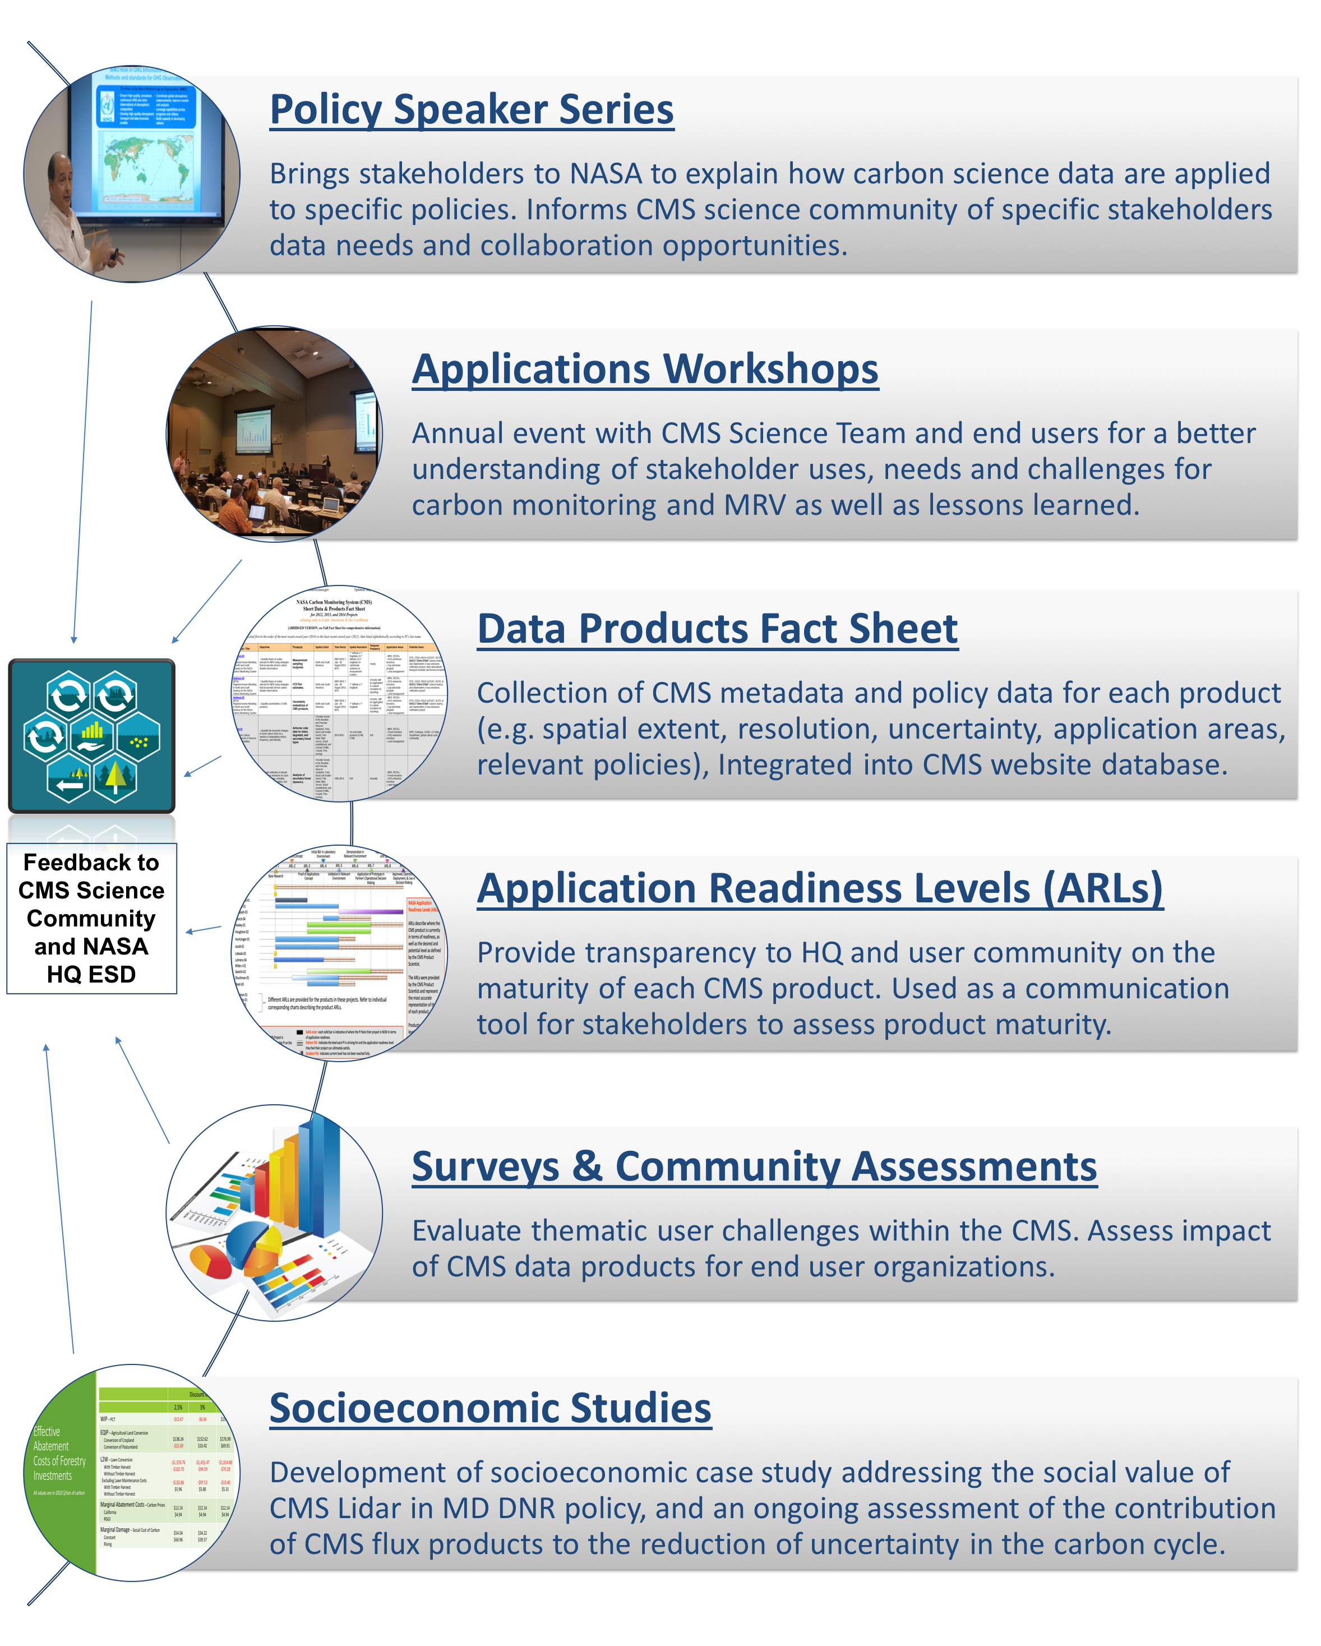
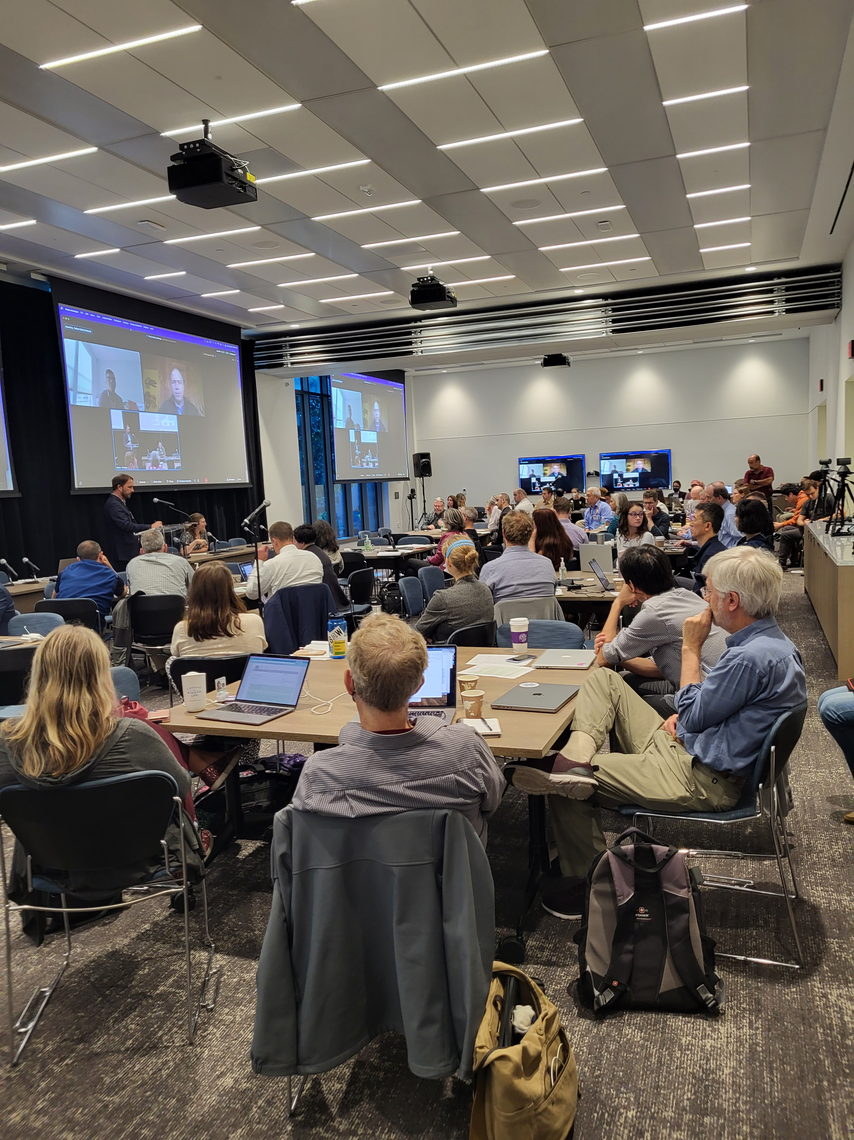
CMS Applications
Program Framework
CMS Applications Efforts Examples. 2022 CMS Applications Workshop in Washington, DC: CMS Applications Workshops and tutorials provide an opportunity for CMS Science Team members and stakeholders to engage on thematically detail objectives that help advance CMS science into appropriately scaled policy arenas.

Slide 4
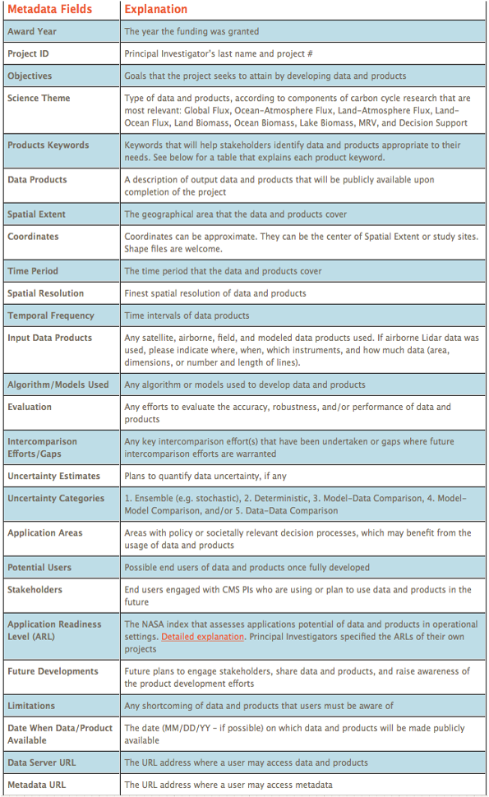
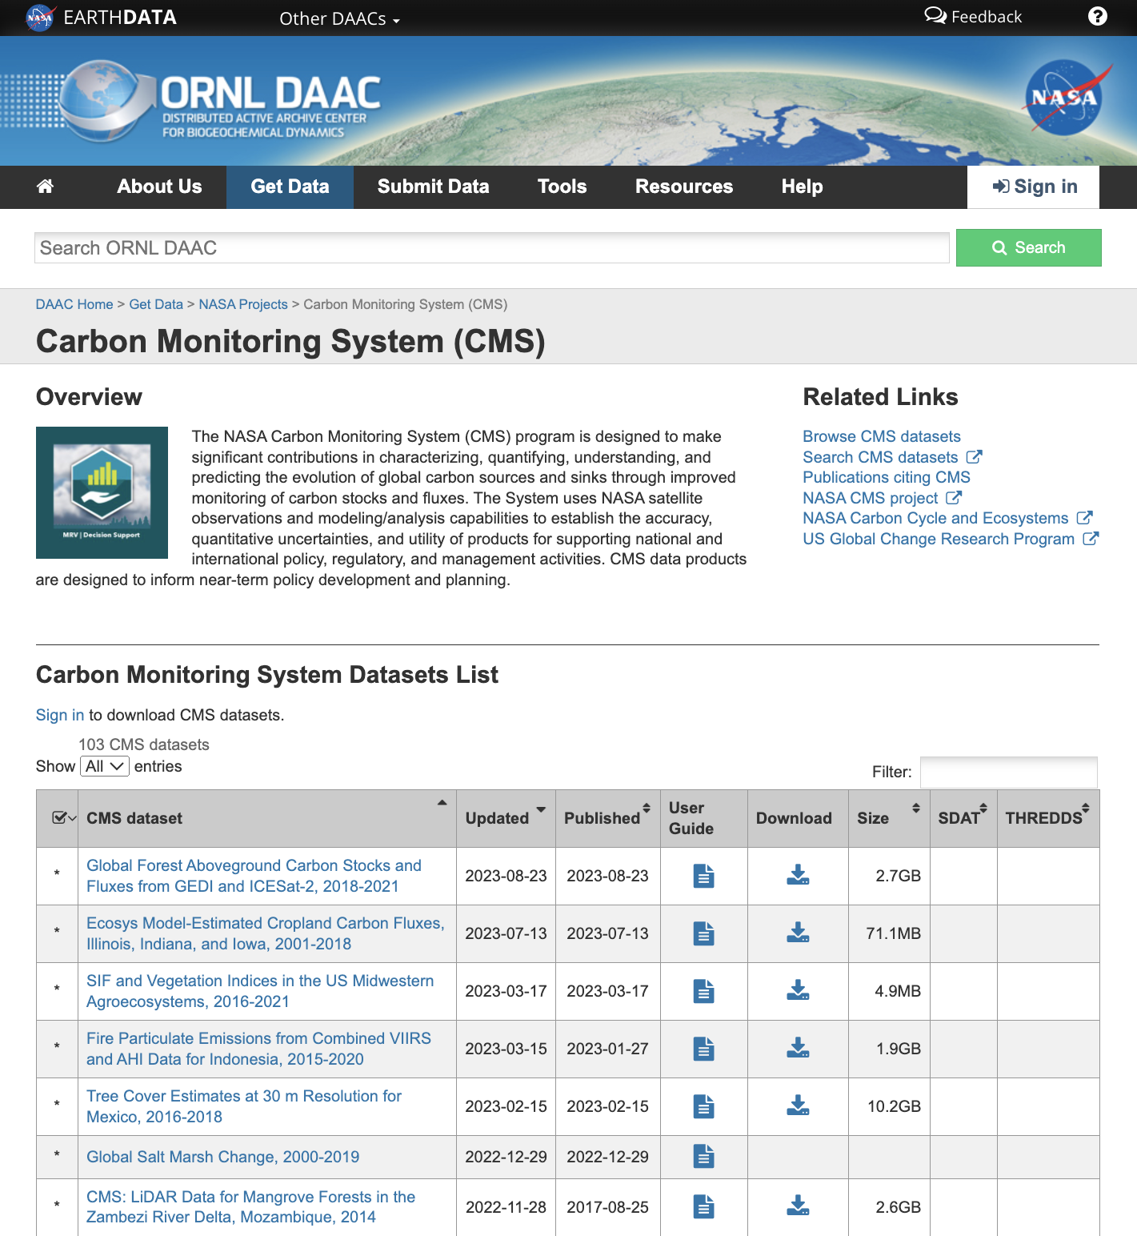
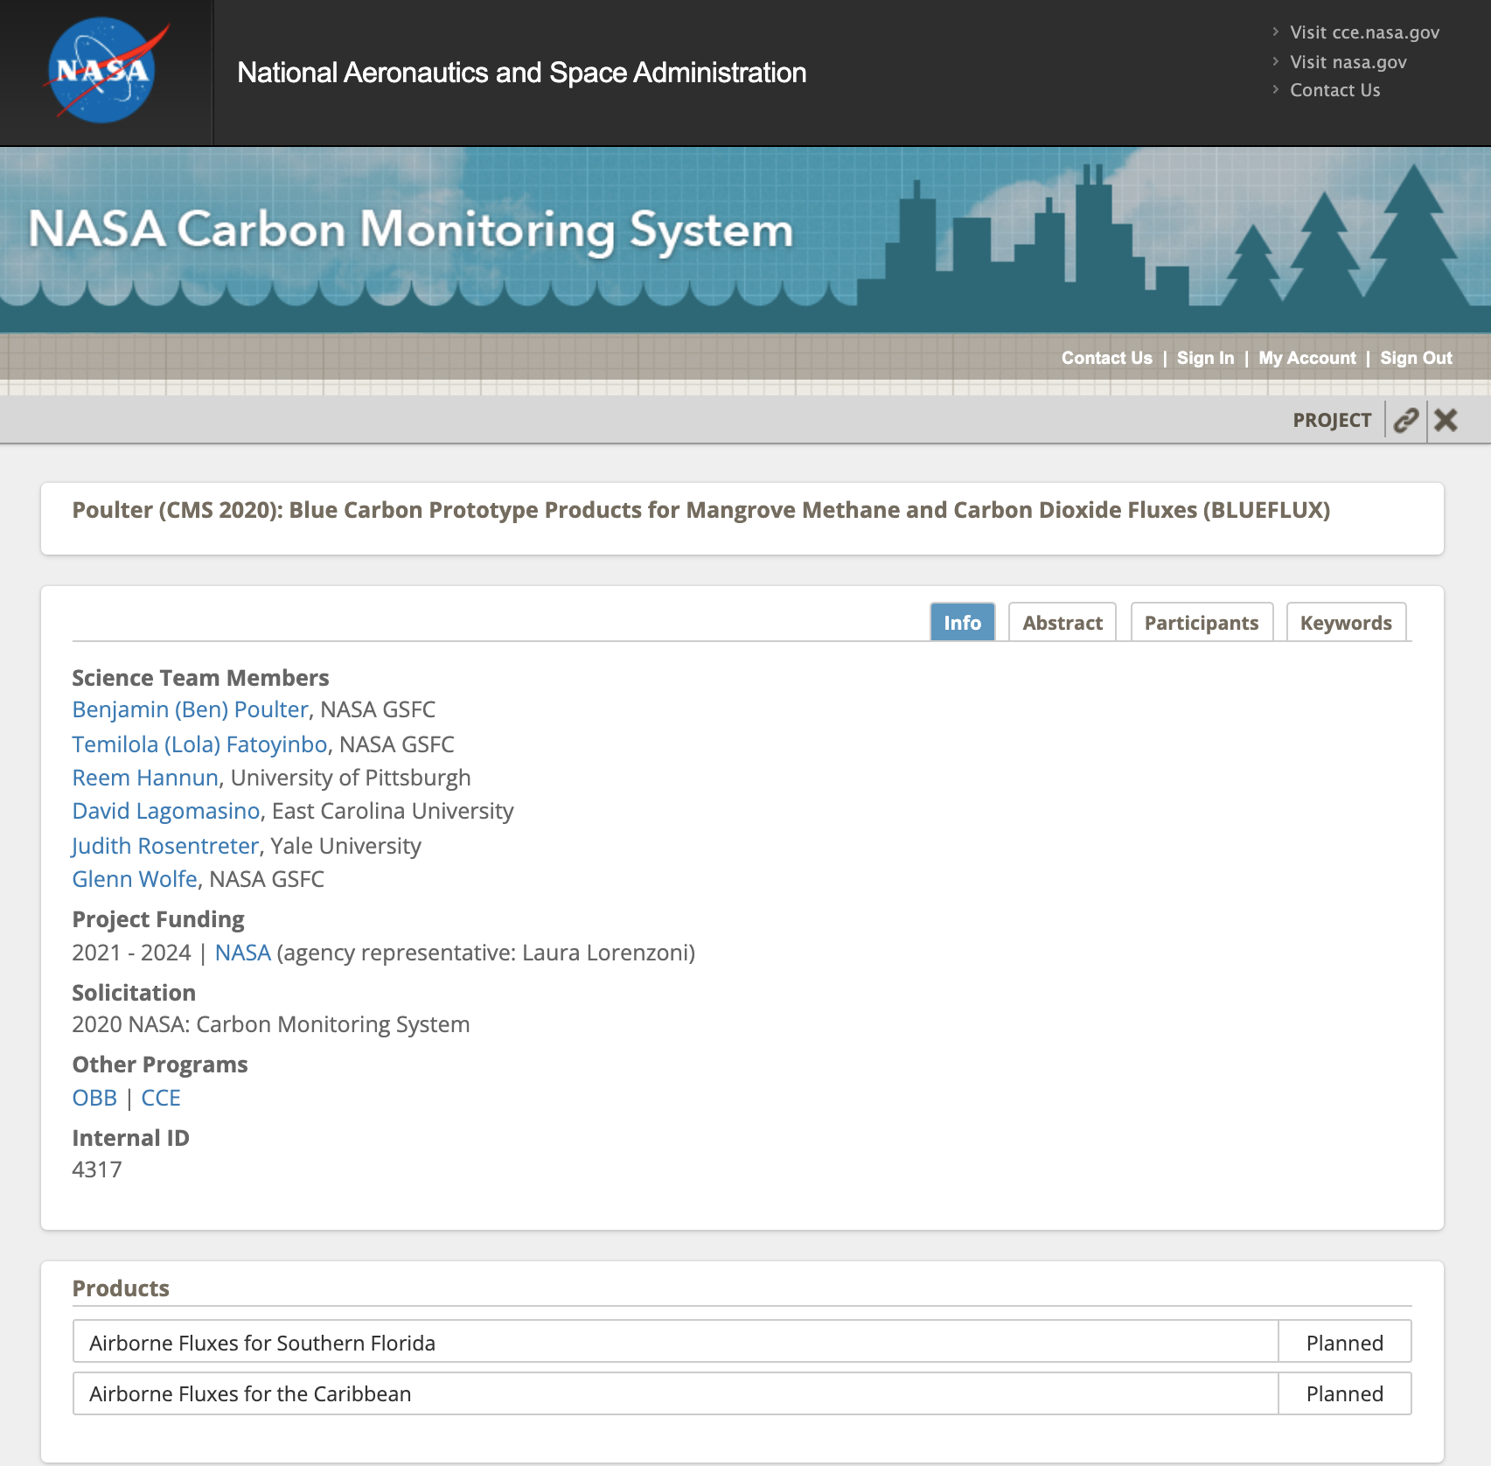
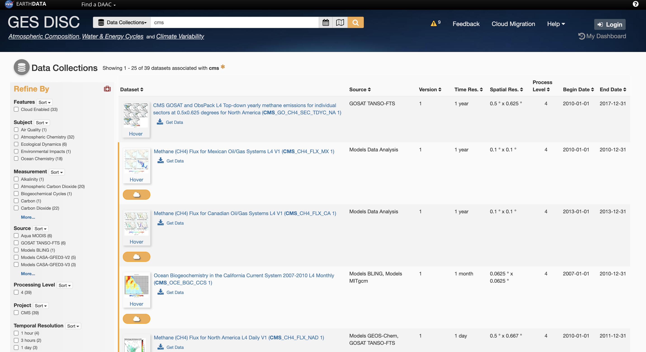
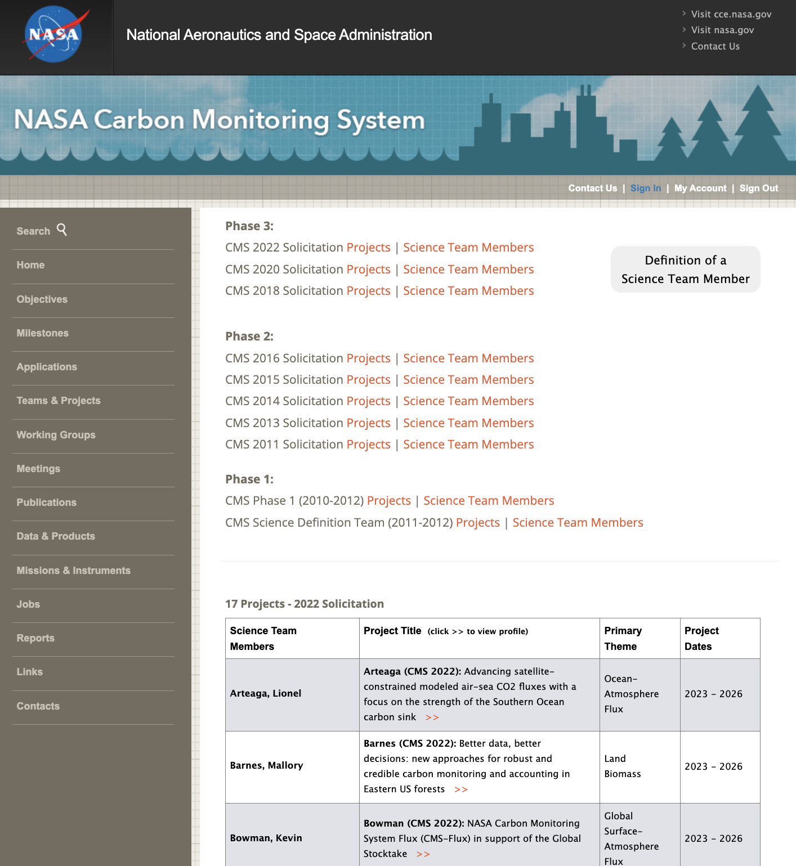
Overview of CMS Data Products
Where can CMS datasets be found?

Slide 5
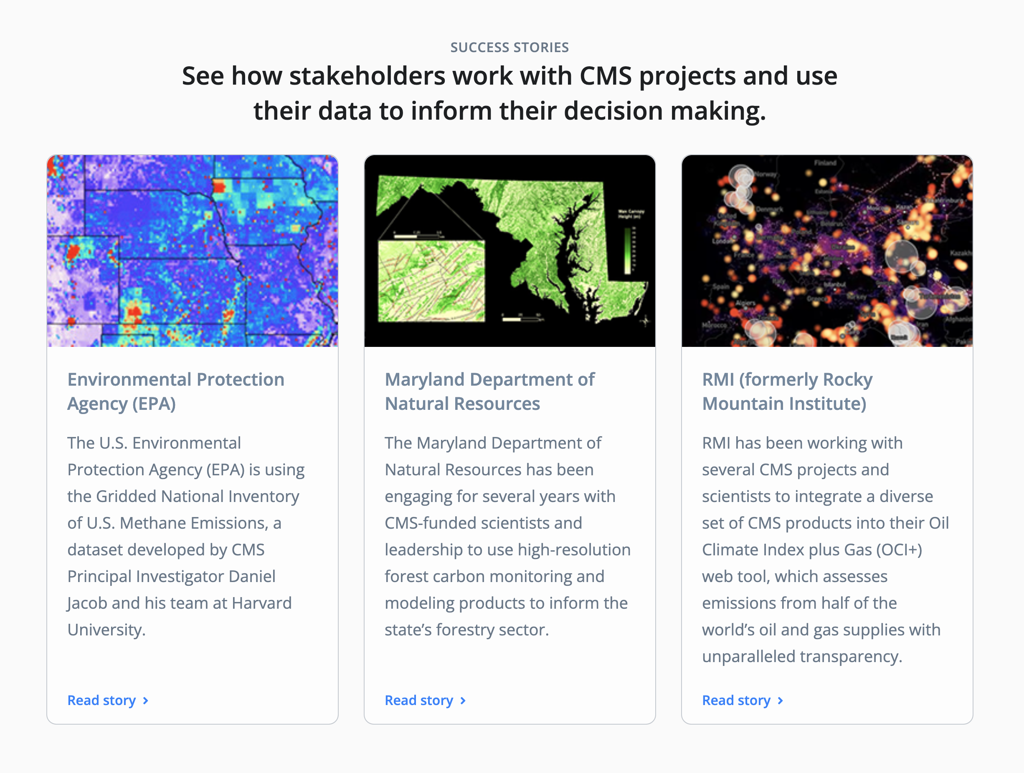
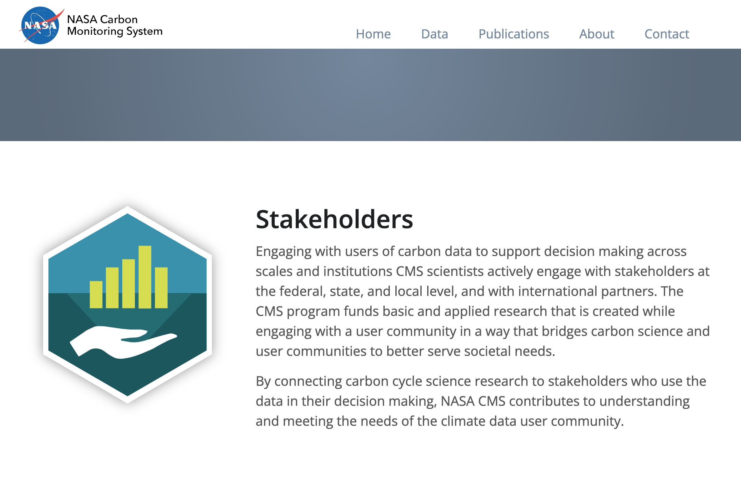
CMS Success Stories in New CMS Website
Will be updated with new success stories identified at this meeting…
Notes:
Propose here to develop success stories form this workshop (and/or CMS Stakeholder Factsheets)

Slide 6
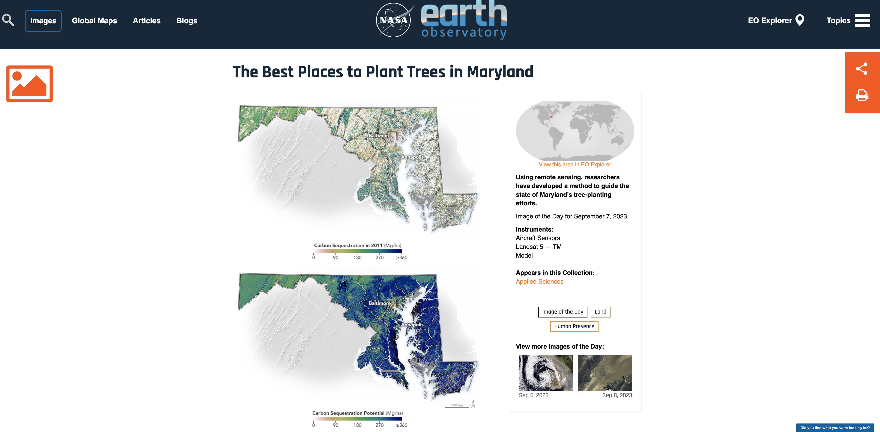
CMS Project Highlighted in NASA News
Maryland is the first state in the nation to use a remote sensing-based system for monitoring forest carbon.
Applications: track carbon fluxes from forests, and afforestation efforts
Keynote Talk: The Dynamic Future of Maryland's Natural Carbon Sinks: Leveraging CMS Data to Chart a Policy Pathway to Net Zero
Rachel Lamb, MD DoE
https://earthobservatory.nasa.gov/images/151796/the-best-places-to-plant-trees-in-maryland
Notes:
Maryland is the first state in the nation to use a remote sensing-based system for monitoring forest carbon. The data products are being used to track carbon fluxes from existing forests and to assess the best places to plant new trees to maximize carbon outcomes. The state aims to plant and maintain 5 million native trees by 2031, as part of its efforts to reduce carbon pollution by 60 percent from 2006 levels.

Slide 7
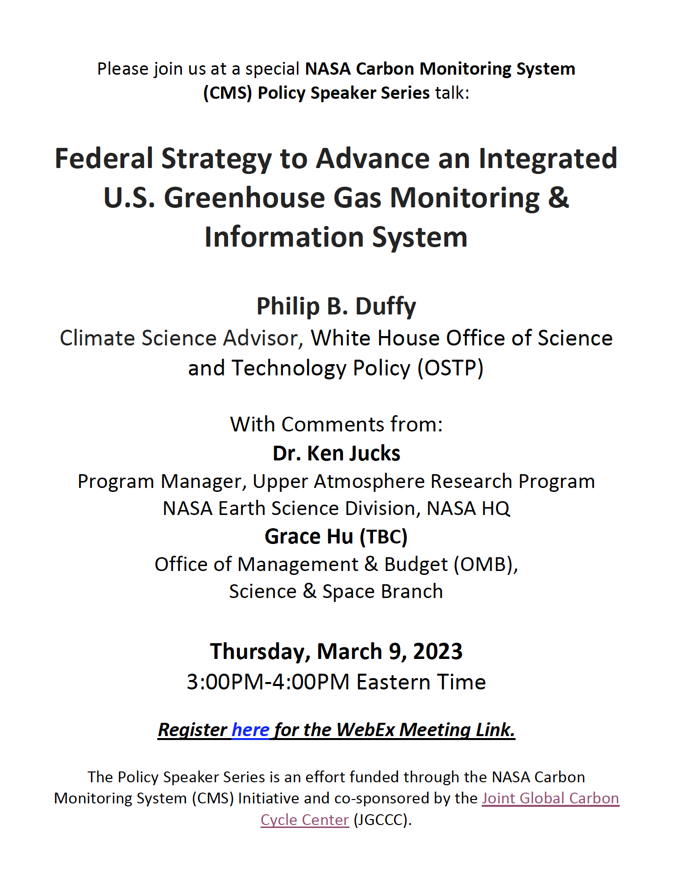
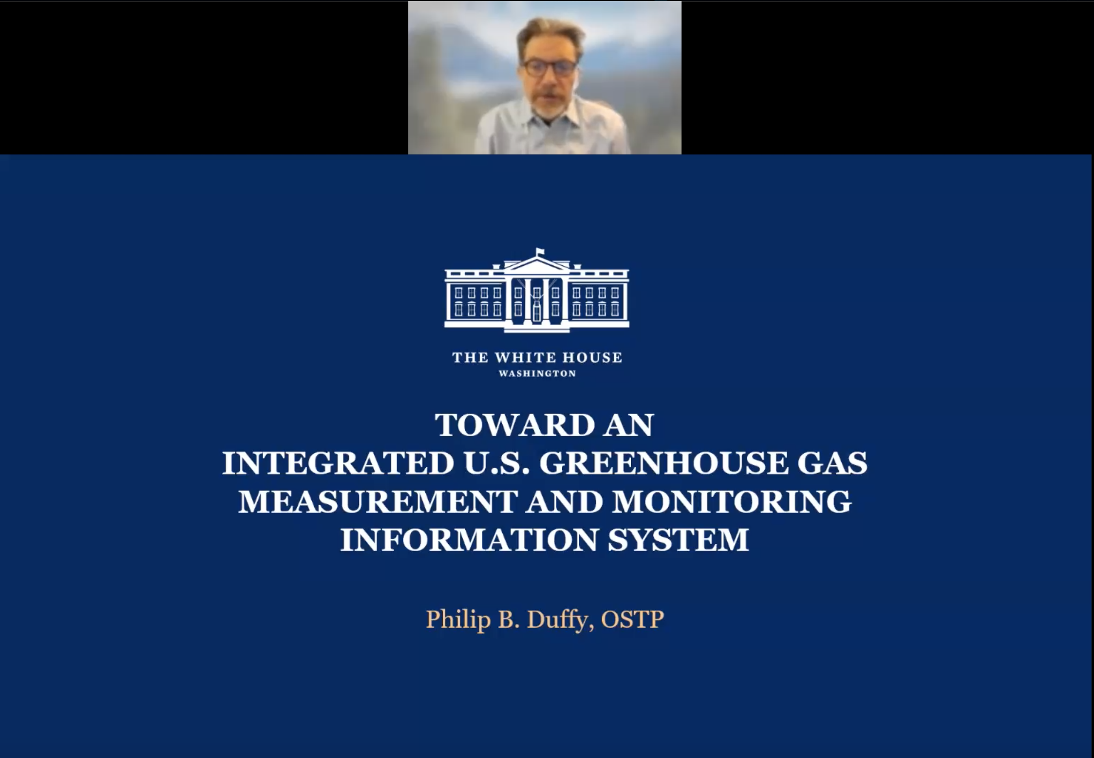
Policy Speaker Series Highlight – Interagency Efforts
Response to RFI to Advance U.S. GHG Information System
Increased awareness of CMS Program & Stakeholder Engagement Efforts
Key takeaway: Increase interagency coordination, and start to involve non-USG entities
More info here: https://carbon.nasa.gov/policy_speaker_09032023.html

Slide 8
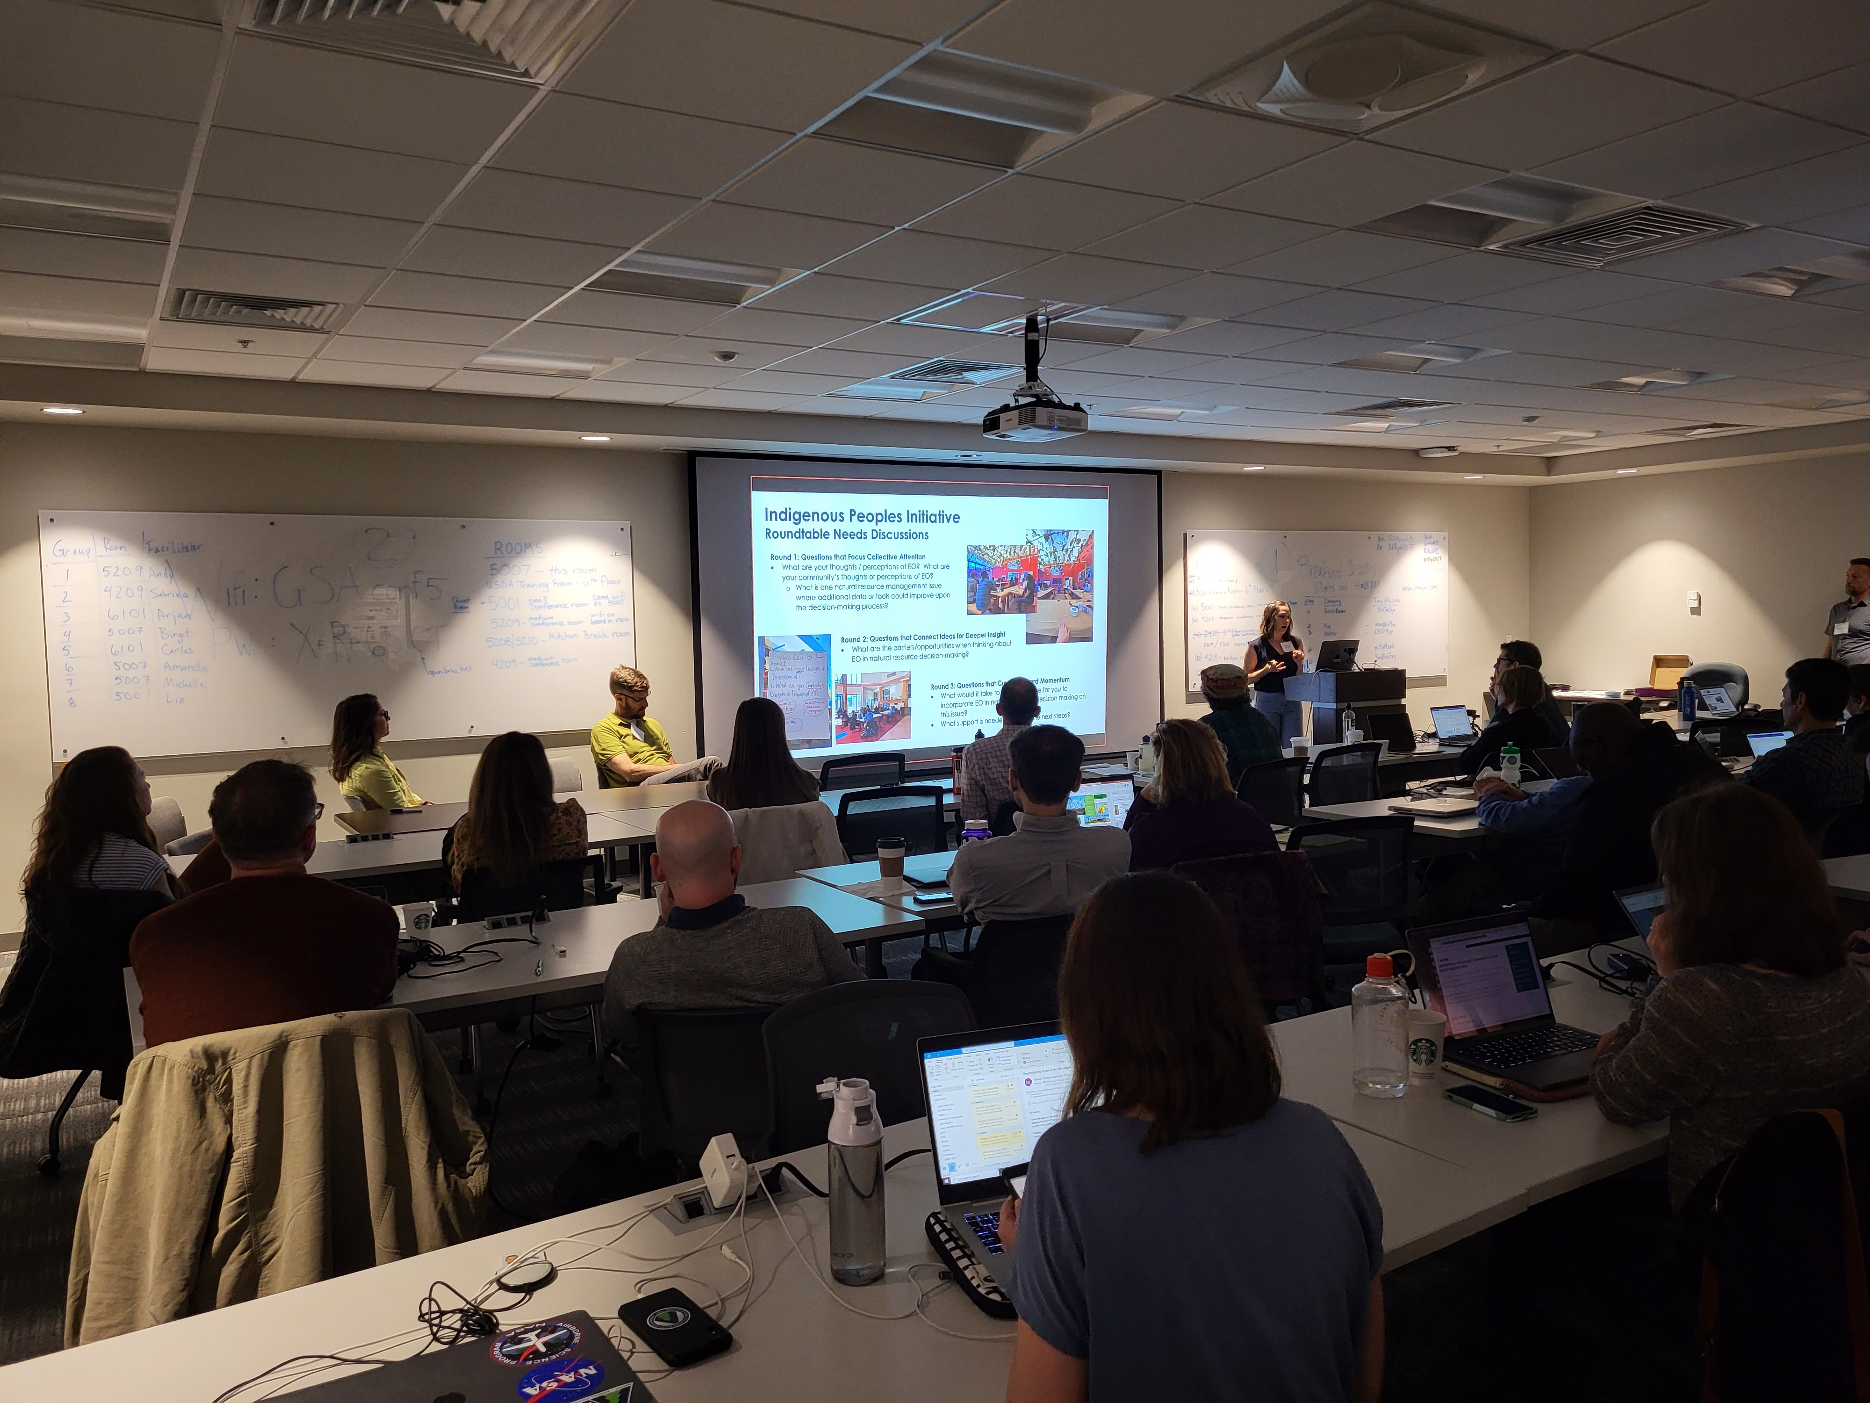
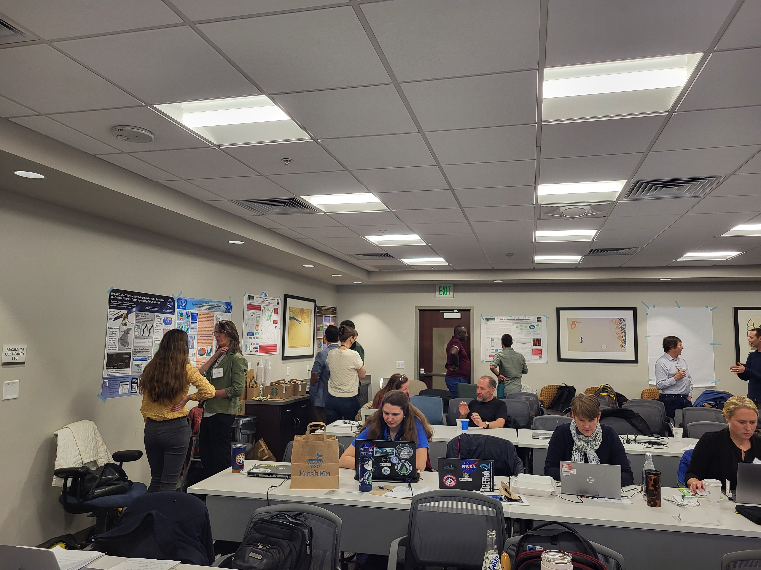
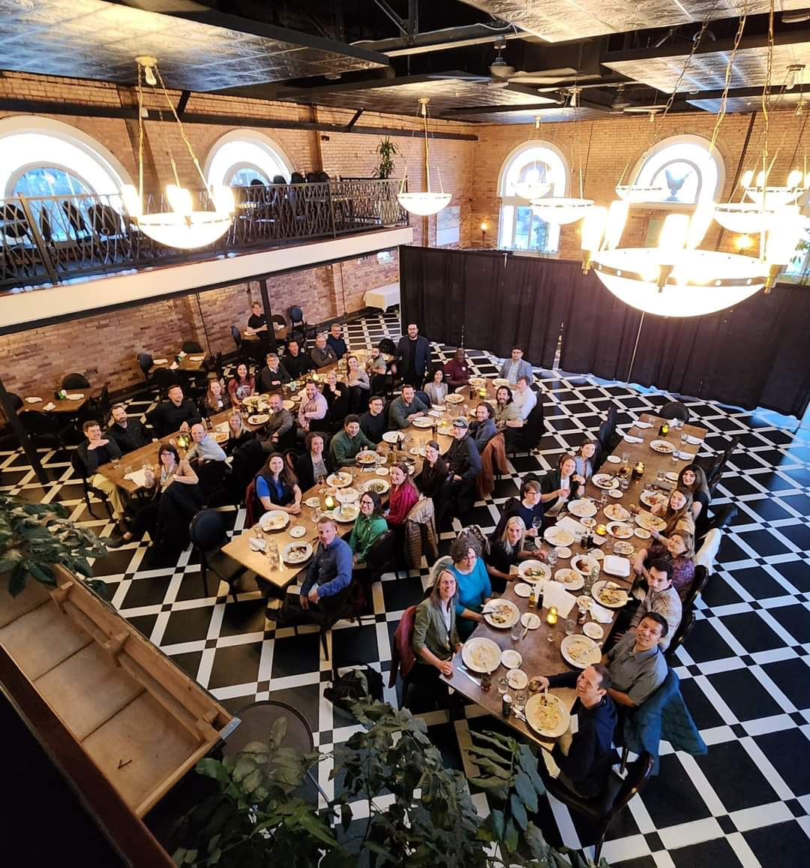
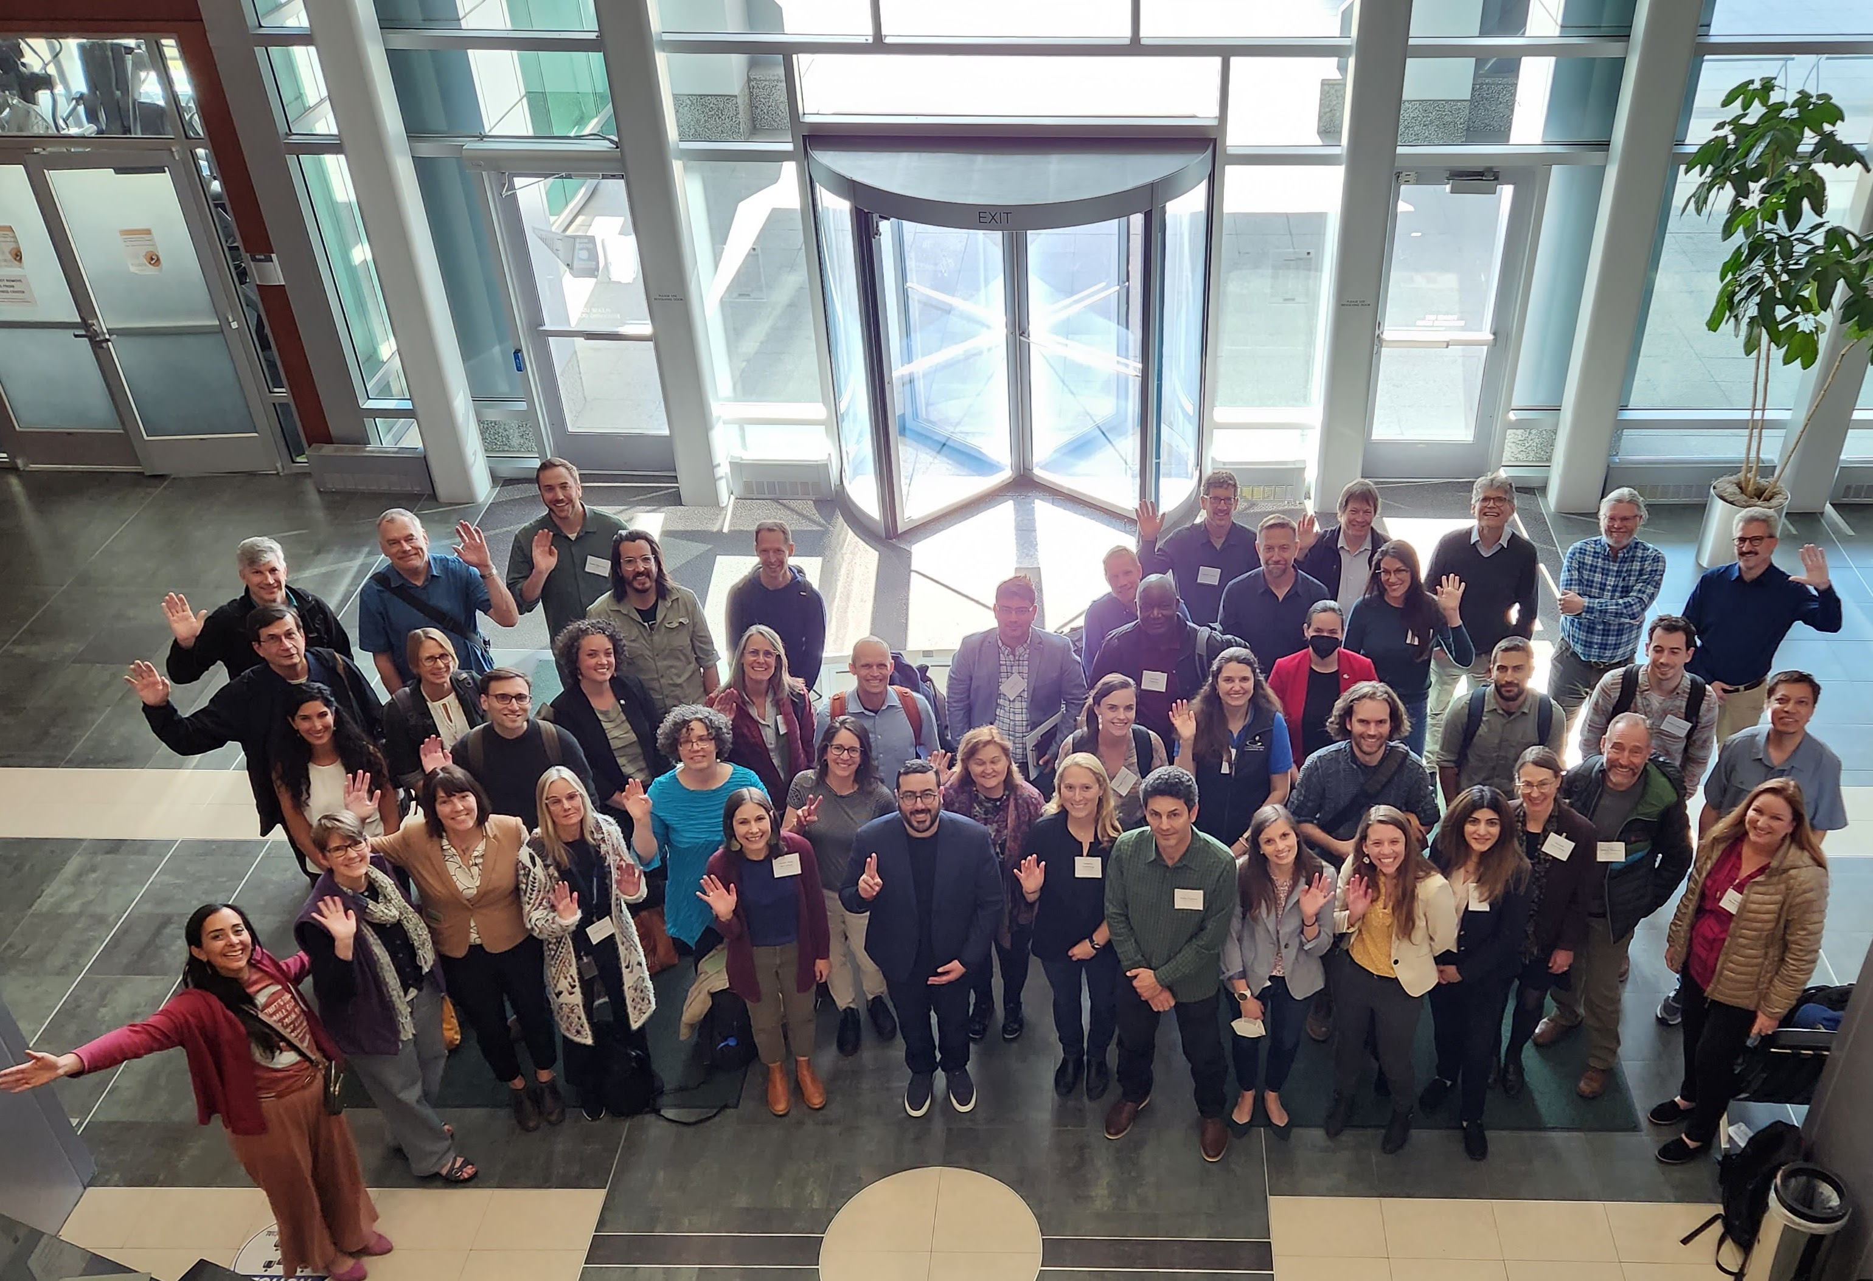
Cross-mission applications efforts – CMS at the AEOIP
Applied Earth Observations Innovation Partnership (AEOIP) - USFS, NASA, USGS, BLM
Fostering interagency partnerships to advance Earth Observation-based land management
2023 USFS – NASA Joint Applications Workshop: ”Addressing Land & Water Monitoring Needs Using Remote Sensing” in Salt Lake City, UT
Workshop Goals: (1) increase awareness at NASA of USFS (and other land management agencies) operational needs, and (2) increase awareness among USFS resource managers of NASA data products that will inform their decisions
Key applications take-aways:
  there is a need and interest in engaging more with non-traditional stakeholders, the private sector, and continue and expand the cross-mission collaborations.
  Identify better ways to engage with stakeholders before and after the funded projects, or the mission.
  Interest in developing a user-friendly needs assessment tool to trace the integration of EO into practical applications.

Slide 9
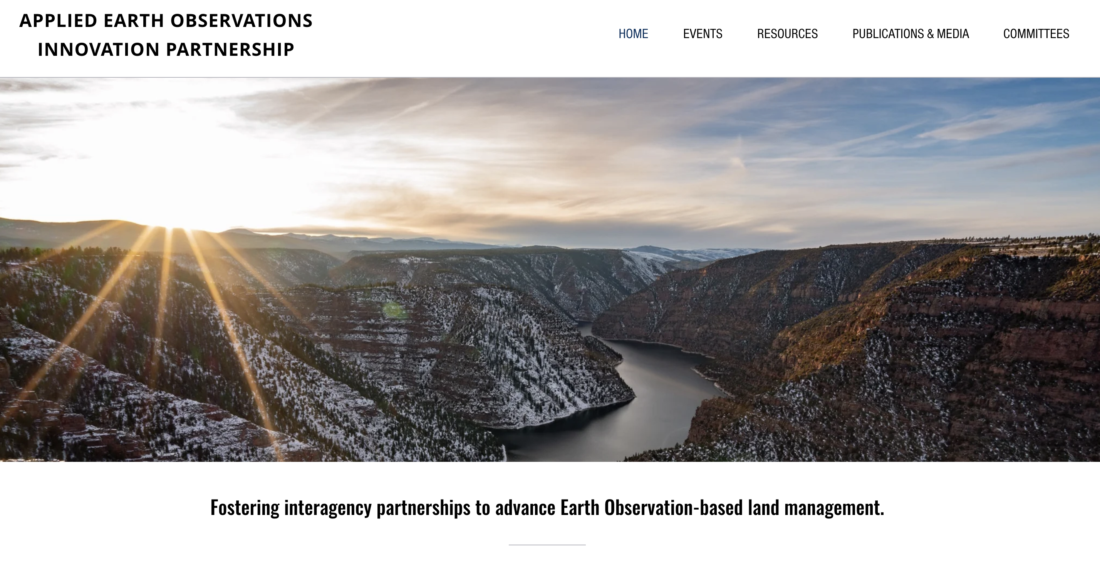
Cross-mission applications efforts – CMS at the AEOIP
AEOIP Workshop on Fire - Spring 2024
Location: Ann Arbor, MI
AEOIP Fire Workshop Leads:
Nancy French & Mary Ellen Miller, Michigan Tech
Jessica Burnett, NASA HQ
Jeff Morisette, USFS
Andy Hudak, USFS
Edil Sepulveda Carlo, NASA CMS
Proposal Funded by: Mike Falkowski, NASA HQ

Slide 10

Cross-mission applications international efforts
- The event will bring the CMS, ICESat-2 and GEDI missions together, with the goal of creating and strengthening existing partnerships that enable communities to become more sustainable through the use of EO.
- Presentation on the CMS Initiative
- Highlight CMS Projects in Mexico
- Stakeholder Panel on the use of CMS and remote sensing-based carbon products for sustainability applications in Mexico
- Carbon Monitoring Training
https://espacioysostenibilidad.com/en/
November 15-16, 2023, in Guadalajara, Mexico
Notes:
As such, this colloquium will aim to review relevant NASA data products, highlight existing applications of the datasets, explore existing uses of Earth Observations from the local and SELPER communities, and discuss opportunities to leverage CMS, ICESat-2, and GEDI data products in their applications.

Slide 11
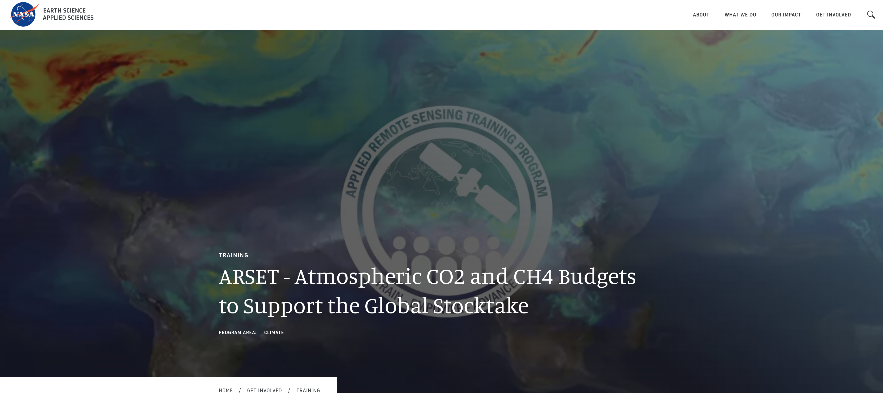
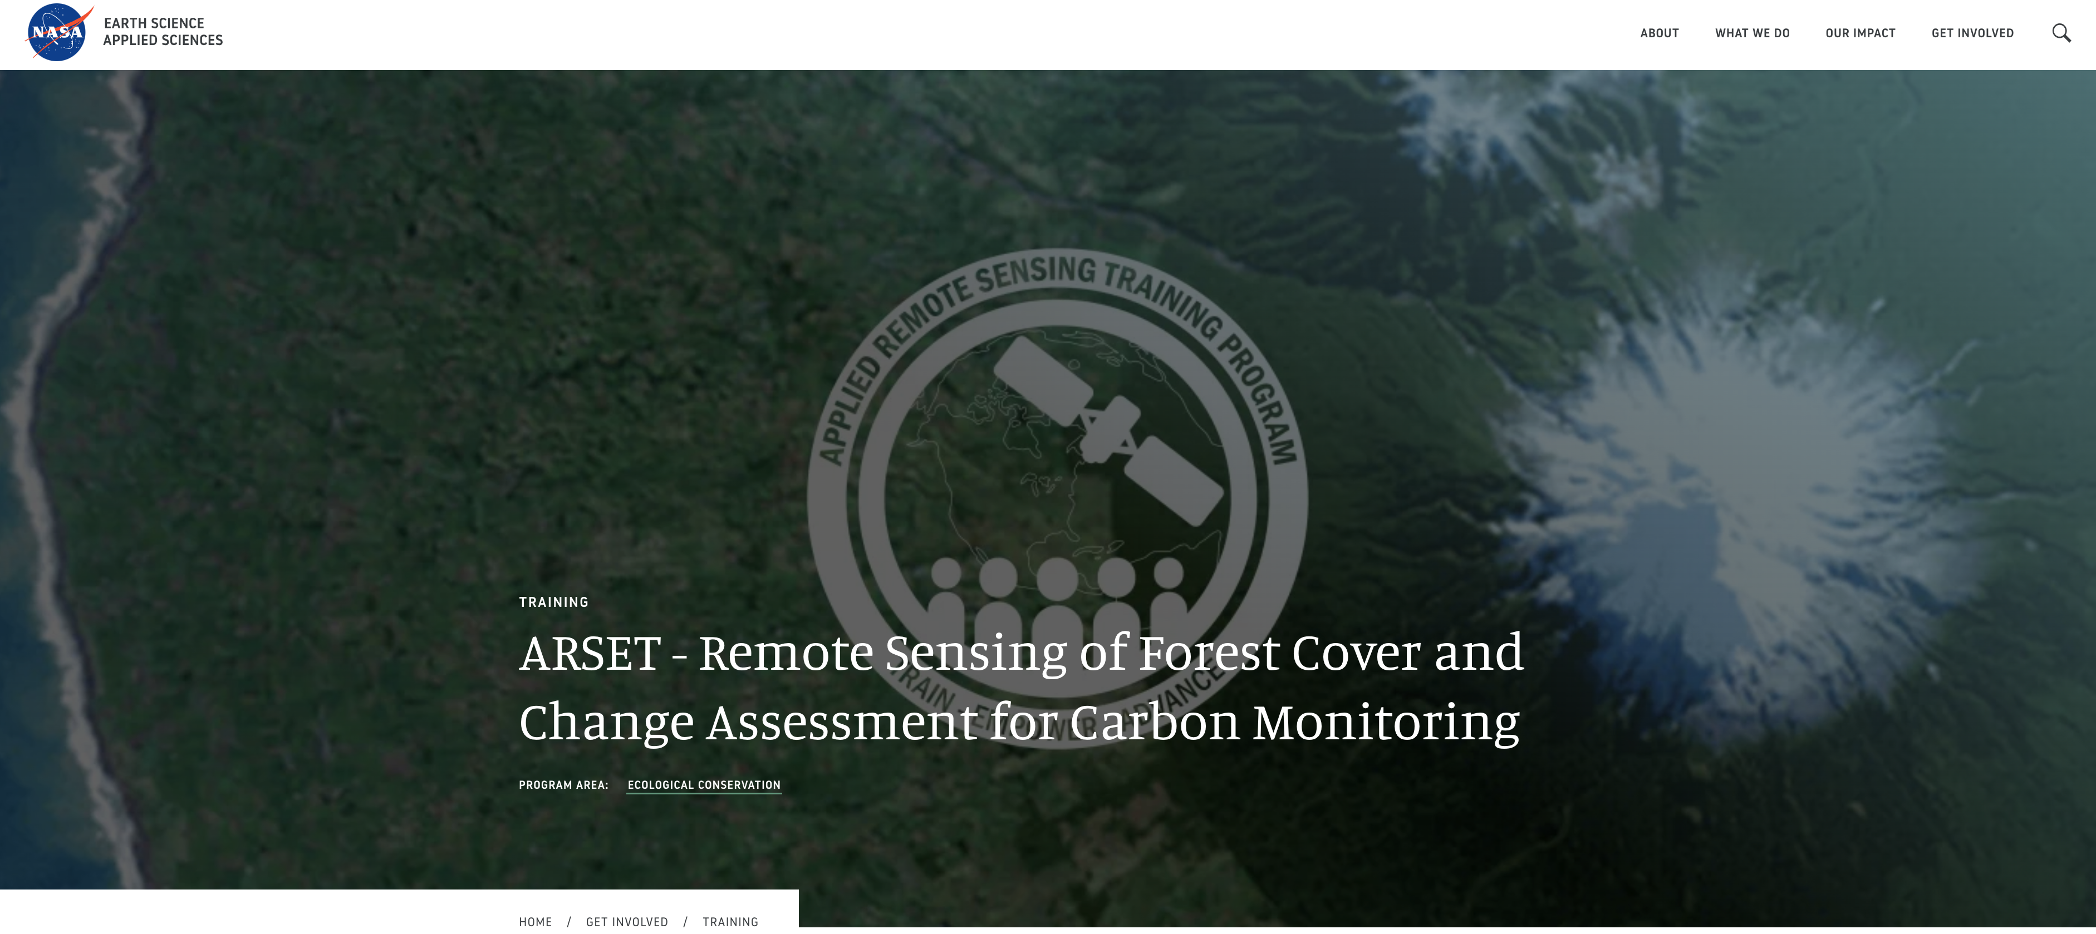
ARSET Trainings in Carbon Monitoring
*Opportunities to develop new trainings in carbon monitoring with NASA ARSET Team – if interested, please reach out!
https://appliedsciences.nasa.gov/what-we-do/capacity-building/arset
Learn to use remote sensing for reporting and verifying carbon estimates
Recognize the need to monitor CO2, CH4, and other greenhouse gases to support efforts to reduce net emissions and mitigate their impact on climate
Notes:
This webinar series is intended for stakeholders at local, regional, and national levels who are interested in managing greenhouse gas emissions to meet the climate change mitigation goals of the Paris Agreement, national inventory developers, and researchers who are interested in developing top-down atmospheric greenhouse gas budgets and working with the inventory development and assessment communities to support the global stocktake process.

Slide 12
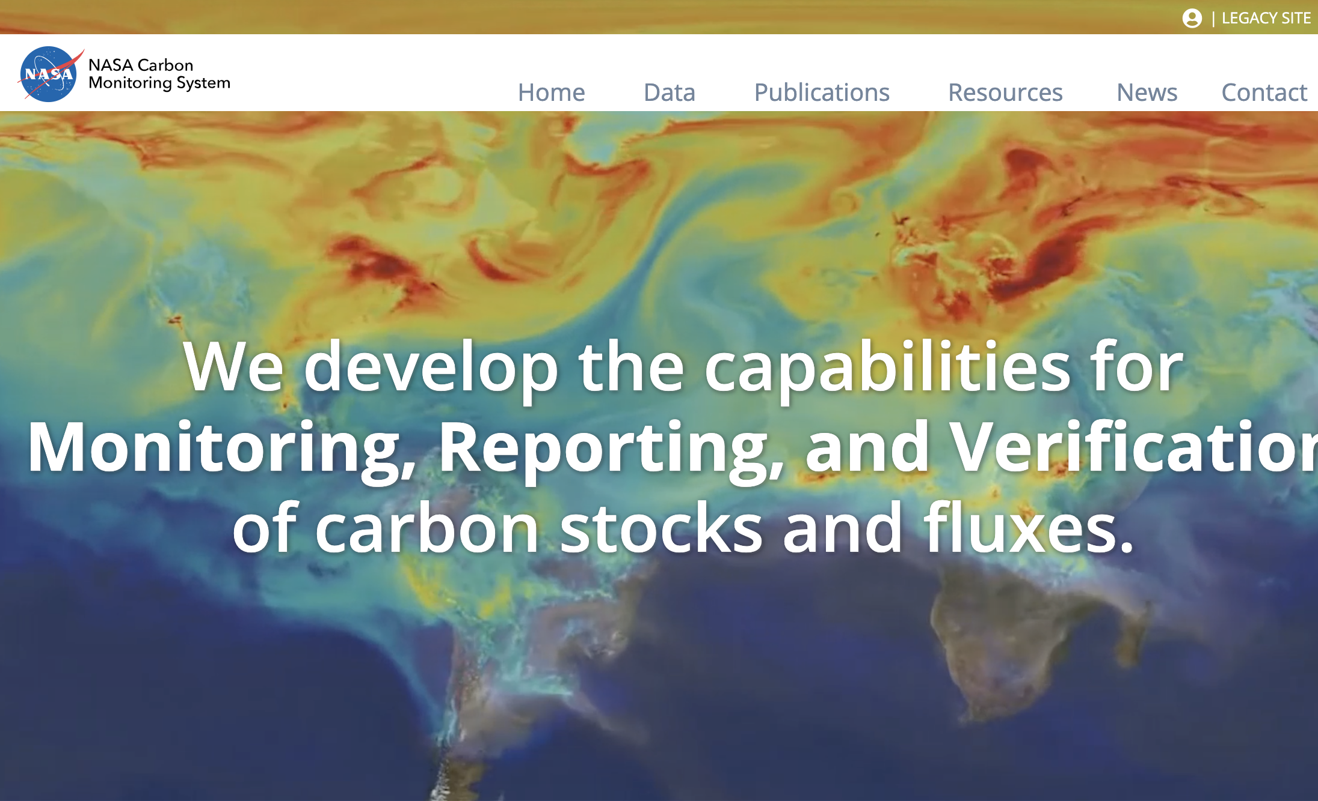
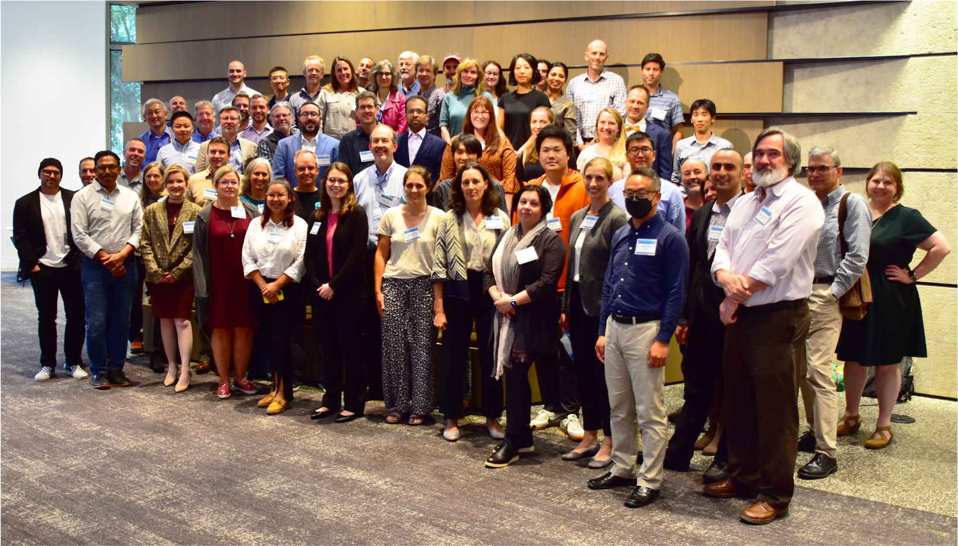
Use of Stakeholder Feedback from CMS Workshop
Developing Success Stories & Updating New CMS Website
Topics for CMS Policy Speaker Series & Workshops
Future Synthesis Reports, & Research Priority Areas
For Cross-Mission Collaboration Efforts & Events
For the Development of ARSET Trainings
Other Ideas & Suggestions?

Slide 13
Reminder - Goals for CMS Applications Workshop
Provide CMS science team members with an opportunity for discussion and collaboration with the stakeholder community.
Identify and understand challenges and data needs of stakeholder community.
Identify positive aspects of CMS data for the work of stakeholders, as well as the next priority and scientific advancements that could contribute towards the goals of the stakeholder organizations.
Compile testimonials from stakeholders about the societal benefits of CMS data products.
CONTACT INFORMATION
Edil Sepúlveda Carlo, CMS Applications Coordinator
O: 301-614-6243 | C: 786-658-0607
edil.sepulvedacarlo@nasa.gov

